Slide 1

VIVEKANAND COLLEGE FOR ADVANCED COMPUTER & INFORMATION SCIENCE (B.C.A)
AFFILIATED TO
VEER NARMAD SOUTH GUJARAT UNIVERSITY, SURAT
SEMINAR REPORT ON
“Robotic Process Automation”
AS A PARTIAL REQUIREMENT FOR THE DEGREE OF
BACHELOR OF COMPUTER SCIENCE
[B.C.A]
Academic Year : 2023-24
GUIDE BY:
Dr. Megha Rana
SUBMITTED BY:
Yash D Moradiya
Exam No:
2594

Slide 2
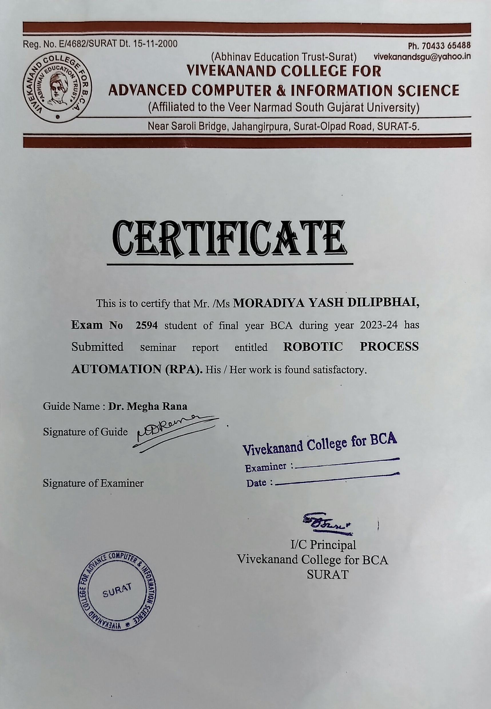

Slide 3
Index
No. | Title | Page no.
1. | What is RPA ? | 4
2. | Introduction | 6
3. | History of RPA? | 7
4. | Working of RPA | 10
5. | Components | 13
6. | Applications of RPA | 16
7. | Advantages of RPA | 19
8. | Disadvantages of RPA | 21
9. | Conclusion

Slide 4
Acknowledgement
The satisfaction that accompanies that the successful completion of any task would be incomplete without the mention of people whose caseless cooperation made it possible, whose constant guidance and encouragement crown all efforts with success. We are grateful to our guide Dr. Megha Rana for the guidance, inspiration and constructive suggestions that helpful us in the preparation of this project. We also thank our colleagues who have helped in successful completion of the project. Thanks to all.
From, Yash Moradiya

Slide 5
What is RPA (Robotic Process Automation)?
The Robotic Process Automation is also known as"RPA". It supports several manual and repetitive tasks to automate like human beings.
We can say that “RPA is a process of creation and training of software bot (automated programs) to automate the business process.”
RPA, or Robotic Process Automation, is like having a digital helper for repetitive tasks. It uses software robots (bots) to do jobs in businesses without needing constant human input. Imagine it as a way to make your computer do routine work on its own.
RPA is a way to create and train these digital helpers to follow specific instructions and perform tasks automatically. The aim is to boost efficiency and cut down on the need for people to do the same task repeatedly.
These bots, or software robots, act as a computer workforce. They mimic human actions, interacting with computer systems just like we do. They follow a sequence of commands, which are like a set of rules, to get their work done. The main idea behind RPA is to shift monotonous tasks to this virtual team of robots, allowing humans to focus on more interesting and creative work.
In a nutshell, RPA is about making work easier by letting computers take care of the routine stuff. We teach these bots what to do, and then they handle the work, freeing up our time for more exciting tasks.
Page 5

Slide 6
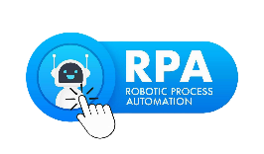
Introduction
The RPA is an acronym for Robotic Process Automation. These three terms are given below:
Robotic: The Robotic means "an entity which can be a program to mimic human actions." The unit or entity which is capable of being programmed by the computer for doing the complex tasks is called a robot.
Process: Process is the sequence of steps that leads to meaningful activity or task.
Automation: when any task happens automatically without human intervention, it is known as automation.
Page 6

Slide 7
creation and training of software bot (automated programs) to automate the
business process.”
The RPA process revolves around software. The developers create and educate the AI
(or the robots), so their actions will emulate authentic humans.
Robotic Process automation(RPA) is the use of software with artificial intelligence (AI) and machine learning capabilities to handle high-volume , repeatable tasks that previously required humans to perform. These tasks can include queries, calculations and maintenance of records and transactions.
RPA technology, sometimes called a software robot or bot, mimics a human worker, logging into applications, entering data, calculating and completing tasks and logging out.
RPA software is not part of an organization's IT infrastructure. Instead, it sits on top of it, enabling a company to implement the technology quickly and efficiently all without changing the existing infrastructure and systems.
Page 7

Slide 8
Robotic process automation (RPA) is a software technology that makes it easy to build, deploy, and manage software robots that emulate humans actions interacting with digital systems and software. Just like people, software robots can do things like understand what’s on a screen, complete the right keystrokes, navigate systems, identify and extract data, and perform a wide range of defined actions.
But software robots can do it faster and more consistently than people, without the need to get up and stretch or take a coffee break.
Page 8

Slide 9
History of RPA
Evolution and Development:
Early attempts at automation date back to screen scraping tools. The modern concept of RPA evolved with advancements in artificial intelligence and machine learning.
1. 1990s - UI Testing Automation:
- Automation debuted in the 1990s with a focus on User Interface (UI) testing, marking the genesis of RPA.
- RPA originated from automating UI testing, ensuring seamless user interactions with applications.
2. 2000 - Banking & Insurance Automation:
- RPA's foundation emerged in the early 2000s with screen scraping technology, optimizing data extraction.
- Initially adopted by banking and insurance for efficiency gains, compliance improvement, and reduction of paperwork.
3. 2010 - Enterprise Automation:
- 2010 witnessed RPA's pivotal adoption by large-scale businesses amid a push for cost-cutting and digital transformation.
- Recognized as a cost-effective solution, RPA gained popularity for mission-critical tasks across enterprises.
Page 9

Slide 10
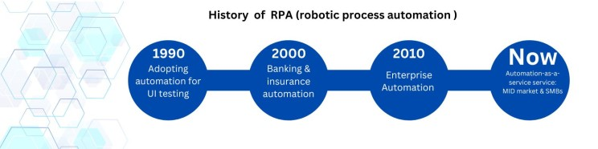
4. Now - Mid-Market and SMBs Automation:
- In the 2020s, RPA democratization accelerated, departing from expensive licensing fees.
- RPA-as-a-service model, facilitated by partnerships with managed service providers, enabled smaller businesses to leverage RPA for significant productivity gains.
Page 10

Slide 11
Working/Functionality of RPA
There are six Functionalities of RPA :
1. Task Identification:
- Repetitive Task: Manually extracting information from invoices.
- Rule-Based: Invoices have a consistent format with specific fields (e.g., invoice number, date, amount).
2. Bot Development:
- Develop an RPA bot using an RPA tool (e.g., UiPath, Automation Anywhere).
- Use the bot to navigate to the designated folder where invoices are stored.
3. Integration with Systems:
- Integrate the RPA bot with relevant applications, such as the email system to fetch incoming invoices or a file system where invoices are stored.
4. Rule-Based Execution:
- Program the bot to open each invoice, identify key fields using Optical Character Recognition (OCR) if needed, and extract information like invoice number, date, and amount.
Page 11

Slide 12
5. Monitoring and Analytics:
- Implement monitoring tools to track the bot's performance, identify bottlenecks, and collect data on the accuracy of data extraction.
6. Continuous Improvement:
- Regularly review the bot's performance and refine its scripts based on feedback. This may involve adjusting OCR settings, updating rules for data extraction, or addressing new invoice formats.
Page 12

Slide 13
Components of RPA
1. Recorder:
- Think of the recorder as the storyteller. It records and remembers the steps you take on your computer, like clicking buttons or typing. Later, these recorded steps become a script for the bots to follow.
2. Development Studio:
- Imagine the Development Studio as your creative workshop. It's where you design how the bots should work. You can use templates, drag-and-drop tools, and create your automation masterpiece without needing to be a coding expert.
3. Plugin/Extension:
- Picture plugins or extensions as handy tools in your toolkit. They are like magic add-ons that help the bots do special tasks without you having to figure out how to do it from scratch. Need to extract data or understand text? There's a plugin for that!
4. Bot Runner:
- Bot Runners are the worker bees. They take the script created by the recorder and run it on different machines. You can have many bots working at the same time, like a team of little helpers getting things done quickly.
Page 13

Slide 14
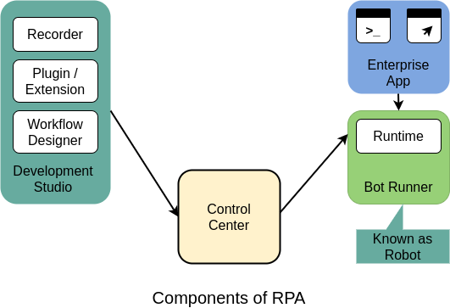
5. Control Center:
- The Control Center is like the mission control room. Here, you schedule, manage, and keep an eye on all your bots. It's where you make sure everything runs smoothly, just like orchestrating a team of robots to complete tasks efficiently.
Page 14

Slide 15
Applications of RPA
1. Data Entry and Migration:
Description: RPA is widely employed to automate repetitive data entry tasks, ensuring accuracy and efficiency. It is also a valuable tool for seamless data migration between systems, reducing manual efforts and minimizing the risk of errors during the transfer.
2. Report Generation:
Description: In the realm of report generation, RPA plays a pivotal role in automating the collection, analysis, and presentation of data. This leads to more accurate and timely report creation, enhancing decision-making processes within organizations.
3. Customer Service & Support:
Description: RPA bots are adept at handling routine customer service inquiries, processing requests, and executing tasks such as updating customer information across systems. This application enhances the efficiency of customer support processes by providing quick and accurate responses.
4. Finance & Accounting:
Description: RPA is extensively utilized in the finance sector for tasks such as reconciling accounts, processing transactions, and generating financial reports. Its precision and speed contribute to more efficient financial processes and improved compliance with regulatory standards.
5. Supply Chain Management:
Description: RPA optimizes supply chain processes by automating critical tasks such as order processing, inventory management, and shipment tracking. This application enhances overall efficiency in supply chain operations, leading to streamlined processes and improved responsiveness.
Page 15

Slide 16
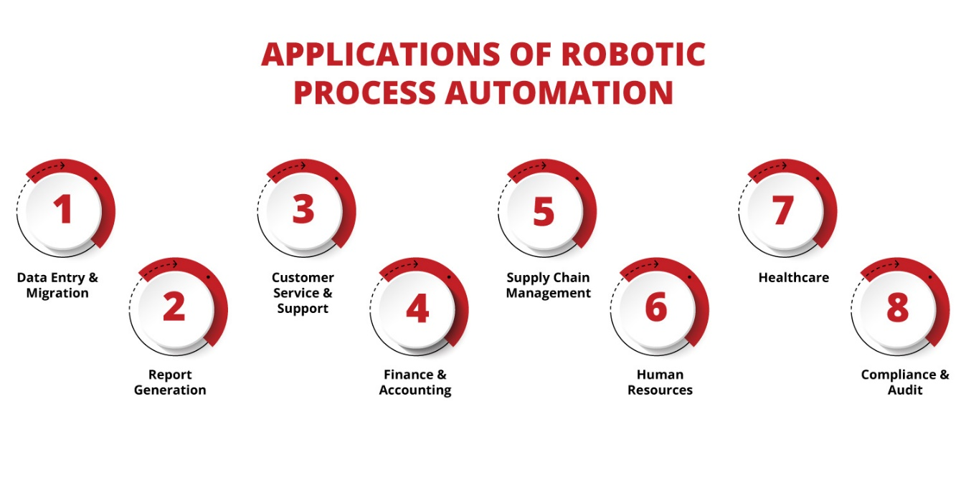
6. Human Resource:
Description: RPA is increasingly being applied in Human Resource functions to automate tasks such as resume screening, employee onboarding, and attendance tracking. This results in increased efficiency and accuracy in managing personnel-related processes, allowing HR professionals to focus on more strategic aspects.
7. Healthcare:
Description: RPA is a valuable asset in healthcare, particularly in automating claims processing. By reducing manual errors and expediting the approval and reimbursement process, RPA contributes to a more efficient and error-free healthcare administration.
8. Compliance & Audit:
Description: Ensuring compliance with regulations is a critical aspect of many industries. RPA aids in this by automating data collection and report generation, significantly reducing the risk of errors in compliance reporting. This application enhances organizations' ability to adhere to regulatory standards.-
Page 16

Slide 17
Advantages of RPA
1.Increased Efficiency:
RPA automates repetitive, rule-based tasks, reducing the time and effort required for manual completion.
Bots can work 24/7 without breaks, leading to faster task execution and increased productivity.
2 Cost Savings:
RPA eliminates the need for manual labor in routine tasks, resulting in cost savings for organizations.
Improved accuracy reduces the cost associated with errors and rework.
3.Accuracy and Consistency:
RPA ensures high accuracy in task execution by following predefined rules consistently.
Minimizes human errors associated with repetitive tasks, leading to improved data quality
4.Quick Implementation:
RPA implementation is typically faster compared to traditional IT projects, allowing for quick deployment and immediate impact on business processes.
5. Automation Suggestions:
- RPA systems can analyze processes and recommend automation opportunities, leveraging data insights to identify areas with the highest potential for improvement.
Page 17

Slide 18
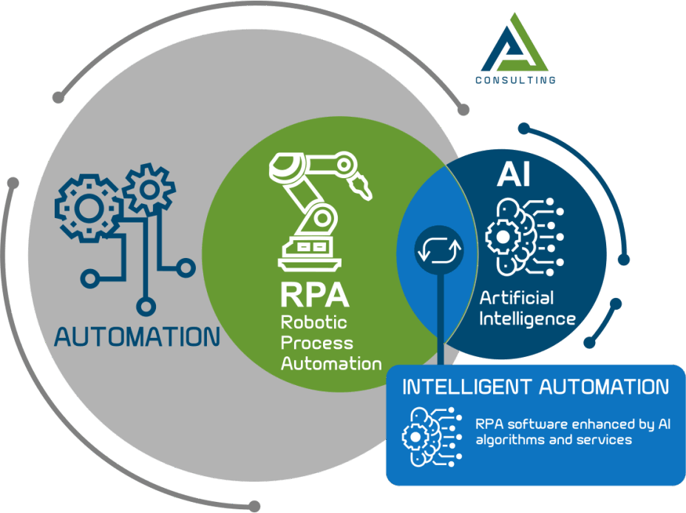
6. Improved Customer Experience:
Faster and more accurate processing of customer requests leads to improved service delivery and enhanced customer satisfaction.
Page 18

Slide 19
Disadvantages
1. Lack of Innovation:
- RPA primarily focuses on automating routine tasks, potentially limiting opportunities for creative and innovative problem-solving within processes.
2. Expensive:
- Implementing RPA can involve significant initial costs, including licensing, training, and infrastructure setup, making it a potentially expensive technology.
3. Lack of Technical Ability:
- RPA implementation and management often require technical expertise. A shortage of skilled personnel or insufficient technical training within organizations can be a barrier.
4. Regular Reconfiguration:
- RPA systems may need frequent updates and reconfiguration to adapt to changes, adding to the workload and complexity of managing RPA implementations.
Page 19

Slide 20
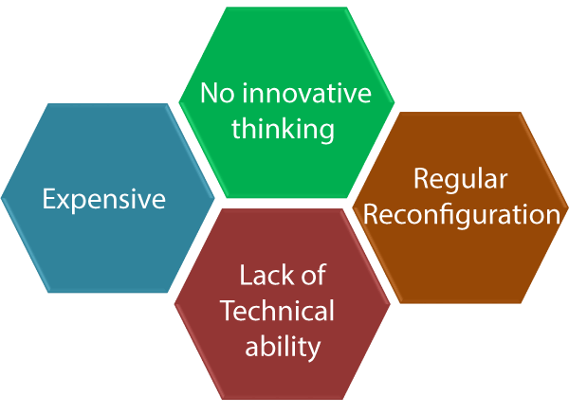
Page 20

Slide 21
REFERENCE
https://www.automationanywhere.com/rpa/robotic-process-automation https://enterprisersproject.com/article/2019/5/rpa-robotic-process-automation-how-explain https://www.youtube.com/watch?v=9URSbTOE4YI https://www.ibm.com/cloud/learn/rpa
What is RPA, Benefits Of Robotic Process Automation (nix-united.com)
Page 21

Slide 22
Conclusion
RPA is a powerful automation solution that offers a variety of opportunities to improve quality, increase control, add flexibility, and unlocks a wide scope of automation possibilities.
Due to its non-invasive integration into the existing system landscape, Robotic Process Automation can be easily introduced and initial processes can be automated quickly. This makes it a good way to approach the topic of digitization in your company or to expand it further.
Page 22

